Slide 1

Customer Analysis for Consumer Goods Company Presented by: Venkata Sai Bala Krishna Batchu Chandratej Kurella Rajashekar Reddy Ayluri Sai Rohith Reddy Nagella Reena Namani

Slide 2
Project Overview
Dataset Overview
Segmentation
Purchase Descriptive Analytics
Purchase Predictive Analytics
Conclusion

Slide 3
Project Overview
The goal of this project is to assist a retail or FMCG (fast-moving consumer goods) organization in developing pricing and marketing plans that will increase sales of each brand of candy bar. Finding the ‘sweet spot’ for price to maximize three customer behaviors—buy likelihood, brand choice probability, and purchase quantity—will help a business realize its full revenueboosting potential.
Regression models were trained using data from consumer purchase histories to forecast these three customer behaviors within a predetermined price range. In order to evaluate how changing prices, affect each of the behaviors, the results were then transformed into price elasticities. As a result, we will be able to identify the best pricing and promotion tactics.
First, in order to assist our study of customer behavior and better position our products, we will segment our client base. This will enable us to create marketing plans that are specific to the needs of customers from various socioeconomic backgrounds.

Slide 4
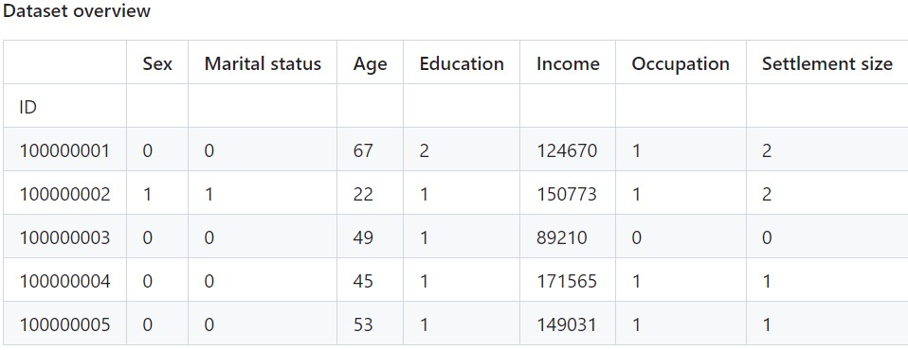
Dataset Overview
Sex: 0 - male, 1 - female
Marital status: 0 - single, 1-non-single
Education: 0 - other/unknown, 1 - high school, 2 - university, 3 - graduate school
Occupation: 0 - unemployed, 1 - skilled, 2 - highly qualified
Settlement size: 0 - small, 1 - midsized, 2 – big

Slide 5
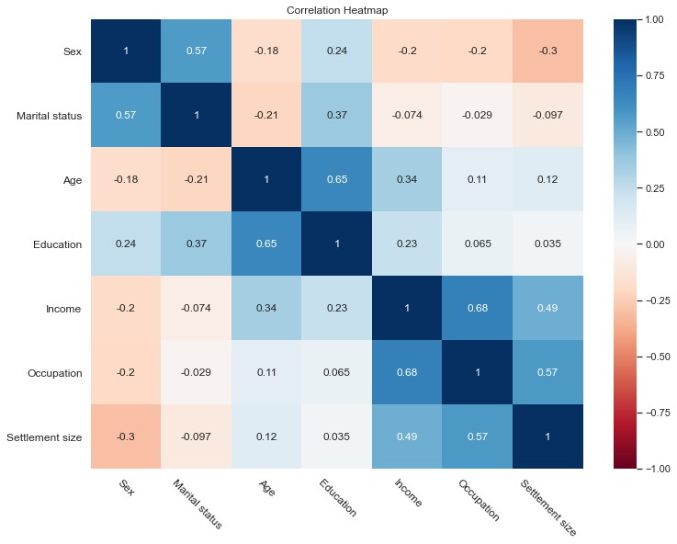
Segmentation
Correlation estimate
In this section, we'll segment our clientele by classifying them into several groups based on seven distinct characteristics. We will be able to examine purchase information by group and develop unique marketing plans for every one of them.
A connection can be seen between some pairs of variables, such as income and occupation, education and age, and settlement size and occupation. It suggests that we can scale back how we represent our consumers without losing too much information, enabling us to classify our clientele more precisely.

Slide 6
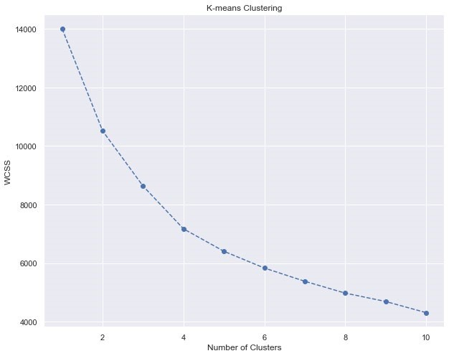
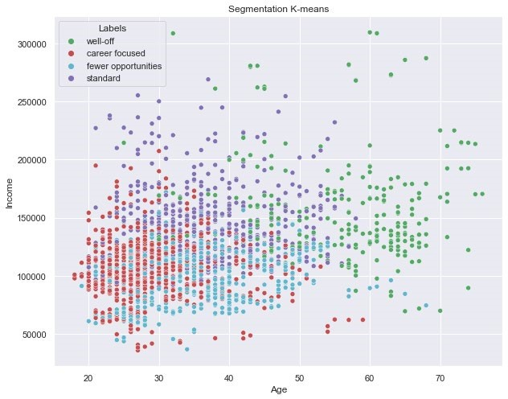
Segmentation
K-Means Clustering
First, using 1 to 10 clusters, we cluster using K-means, and we display the Within Cluster Sum of Square (WCSS).
It's challenging to distinguish between the groups if we only use 2 dimensions to depict the segmentation. Therefore, we need to perform the clustering with PCA

Slide 7
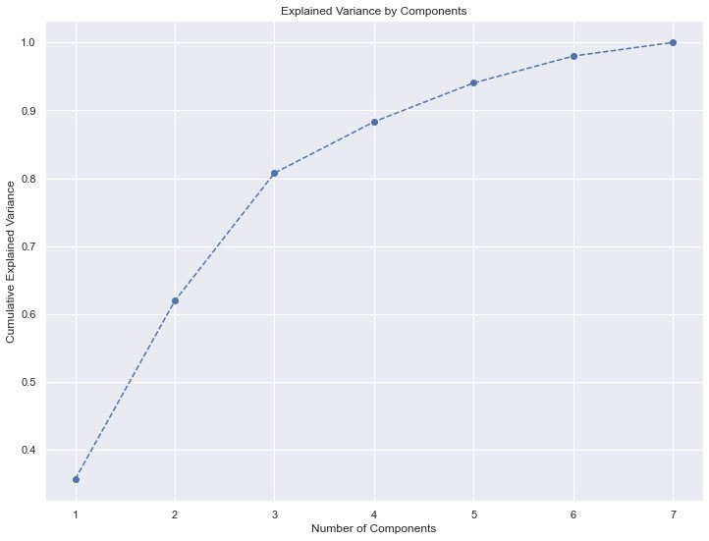
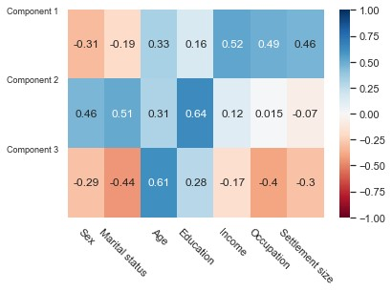
Segmentation
PCA
Visualize the loadings by heatmap
Our data are represented by 3 components that account for more than 80% of the variance.
Component 1: relates income, occupation, and settlement size to the career focus.
Component 2: relates gender, marital status, and education to indicate the individual's lifestyle and education.
Component 3: relates marital status, age, and occupation to the amount of experience (work and life).

Slide 8
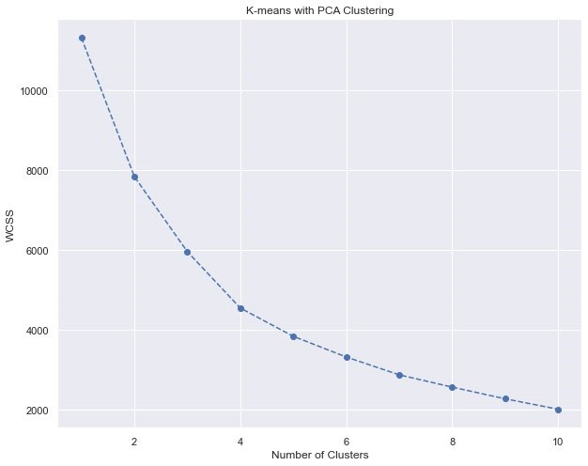
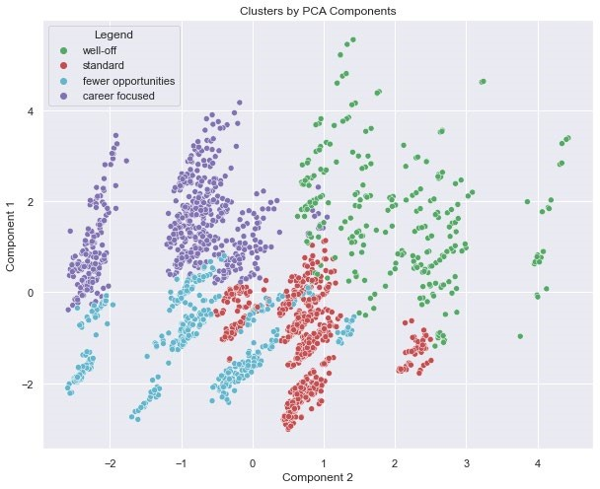
Segmentation
PCA and K-Means Clustering
We obtain the WCSS above by fitting K means to the converted data from the PCA.
Again, we choose 4 clusters to fit our data, and get the above results.
We plot data by 2 PCA components: Y axis - component 1, X axis - component 2.

Slide 9
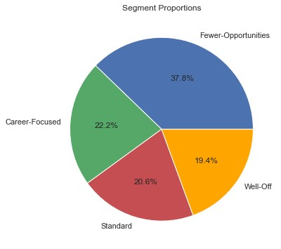
Purchase Descriptive Analytics
Data segmentation
Insights : In our store, we'll typically observe candy bars being purchased in smaller groups with fewer opportunities. There are several potential
They represent the largest clientele groups (add more observations)
They go to the store more frequently than the other customers (more visits result in more purchases).
whenever they go shopping, people are more likely to buy candy bars. We shall look into this more below.

Slide 10
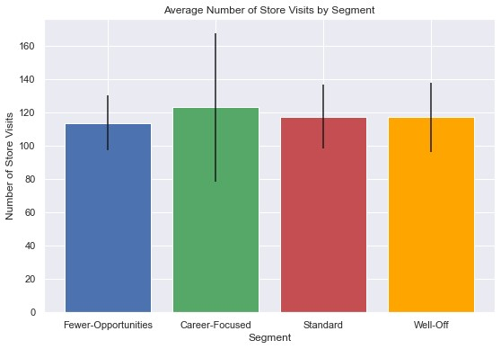
Purchase Descriptive Analytics
Purchase Incidence and Purchase Occasion
Use a bar chart to show the average number of store visits for each of the four segments, and a straight line to show the standard deviation.
Insight :
The standard deviation for “career orientation” is fairly high. This means that customers in this segment are at least homogeneous. That is, they are at least similar in terms of how often they visit the grocery store.
Standard, low-opportunity, and wealthy clusters are very similar in terms of average in-store purchases. This is welcome information and will make comparisons easier in future analyses.

Slide 11
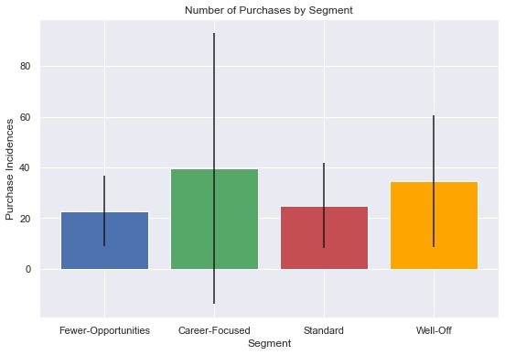
Purchase Descriptive Analytics
Number of purchases by segment
Insight :
The standard deviation is highest for carrier orientation. This could mean that one part of the segment buys the product very frequently and another part less. Consumers in this segment earn about the same, but they may spend their money differently.
The most uniform segment seems to be the segment with the least opportunity. This is indicated by the segment with the lowest standard deviation or the segment with the shortest vertical line.
The standard segment is also consistent, with an average purchase count of about 25 and a standard deviation of 30.

Slide 12
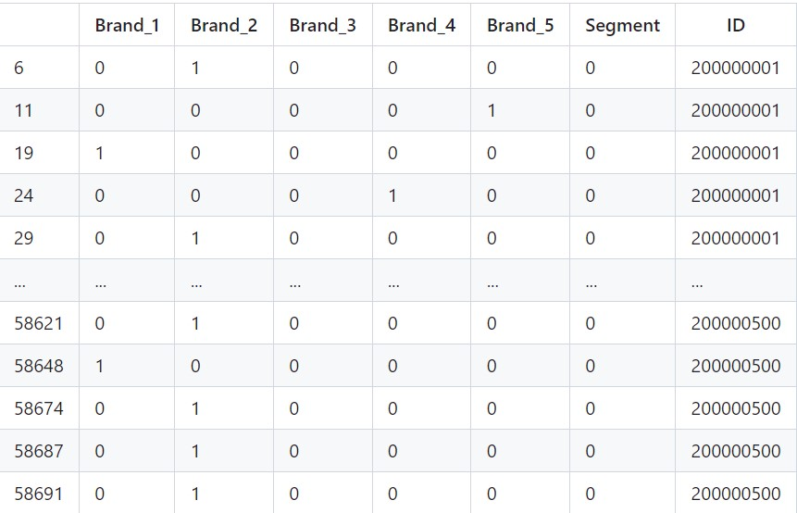
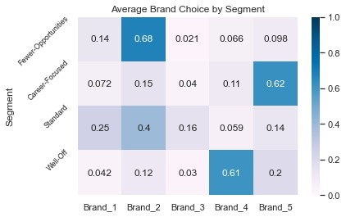
Purchase Descriptive Analytics
Brand Choice

Slide 13
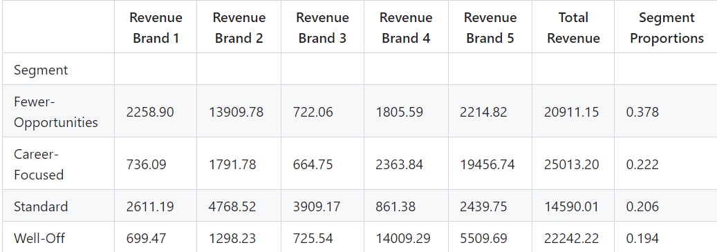
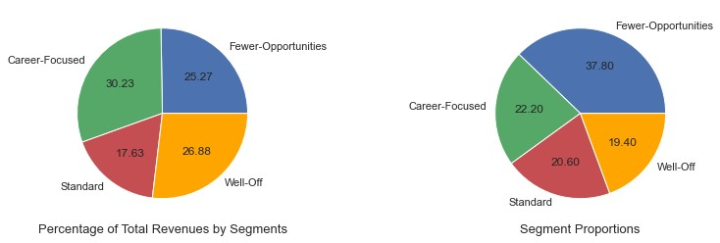
Purchase Descriptive Analytics
Revenue

Slide 14
Purchase Descriptive Analytics
Revenue
insight:
Career focus brings the highest revenue, but is nowhere near the largest standard segment by total purchases
Well-offs have the second highest turnover despite being the smallest segment
Standards are not the smallest segment, but they contribute the least as they tend to buy lower priced products.

Slide 15
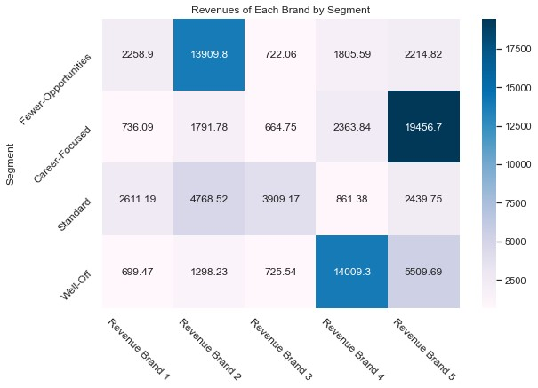
Purchase Descriptive Analytics
Revenue
Insights:
Brand 3 does not have any segment as its loyal customers. If brand 3 reduces its price, the standard segment could pivot towards it since they seem to be struggling between brand 3 and brand 2.
Well-off segments mostly prefer brand 4, followed by brand 5. They seem to be not affected by price. Therefore, brand 4 could cautiously try to increase its price. (hypothesis here: will retain most of the customers and increase the revenue per sale)
For career-focused, Brand 5 could increase its price.

Slide 16
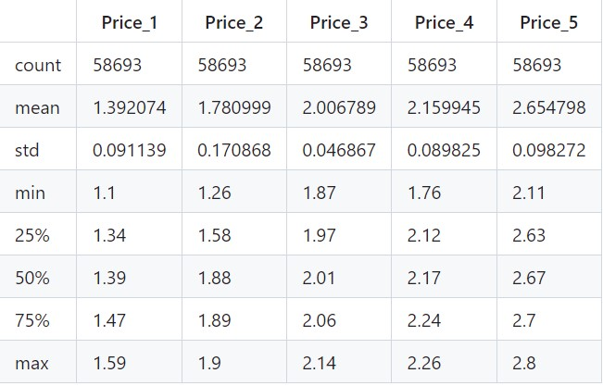
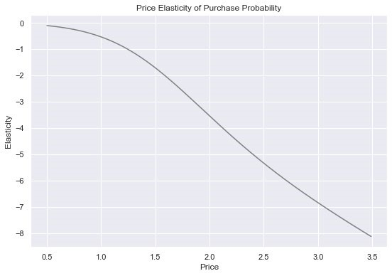
Purchase Predictive Analytics
Purchase Probability
insight:
Overall price should be lowered to increase overall purchase probability
If the price is below the 1.25, we can raise the product price without losing too much potential to buy. Above 1.25 you can get more profit by lowering the price.
This is not good news as the average price for all brands is over 1.25. Each segment needs further research.

Slide 17
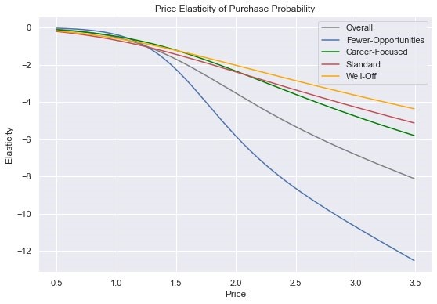
Purchase Predictive Analytics
Purchase Probability of Segments
Insight :
Wealthy segments are the least resilient compared to the rest of the segments. Therefore, the elasticity of purchase probability is not affected by price. Fewer opportunities are more price sensitive than other groups
The price elasticity of the low-opportunity segment appears to vary by price range (low for low prices, high for high prices).
This segment enjoys candy bars so much that higher prices on the low end won't hurt them. When it gets expensive it doesn't make financial sense for them to invest in it.

Slide 18
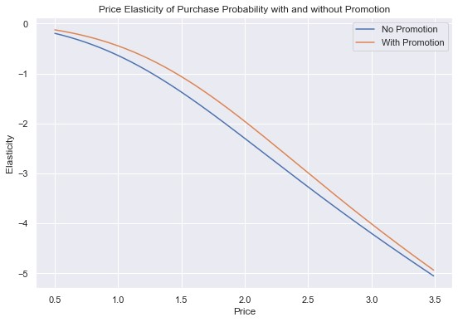
Purchase Predictive Analytics
Purchase Probability with and without Promotion feature
Insight:
At the same time, by applying promotions, we can raise our prices a bit without fear that they will be less likely to buy our products.
The elasticity of the customer's purchase probability becomes less elastic due to the promotion
This is an important insight for marketers. Because, according to our model, people are more likely to buy an item when there is a promotion than to buy it at the same price when it's not on sale.

Slide 19
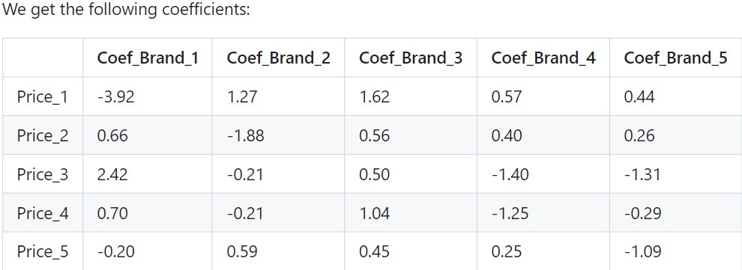
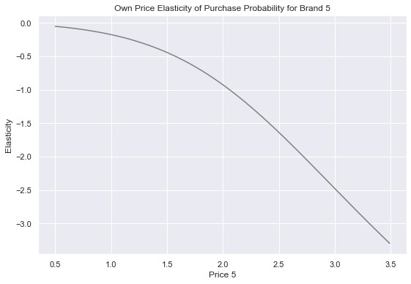
Purchase Predictive Analytics
Brand Choice Probability
Own Price Elasticity Brand 5
Interpretation:
Each coefficient shows how price changes affect the likelihood of choosing the corresponding brand. In general, the lower your own price and the higher the price of other brands, the more likely you are to choose a brand
Interpretation: It shows us how it would affect brand 5 if they change their own price.
We visualize the cross-price elasticity of purchase probability for brand 5 vs brand 4

Slide 20
Purchase Predictive Analytics
Cross Price Elasticity of Brand 5 wrt Brand 4
insight:
Brand 4 is a strong alternative to Brand 5 at all prices up to $1.65.
Note:
The observed price range for Brand 4 is between $1.76 and $2.6 in the region
These prices are outside the natural range of Brand 4, so if Brand 4 were significantly lower in price, it would be a very strong competitor to Brand 5.
The elasticity drops from the 1.45 level, but is still positive, suggesting a slowdown in the increase in purchase probability at level 5.
Brand 4 is no substitute for Brand 5 when it comes to the average customer.
Brand 5 can create marketing strategies that target customers who choose Brand 4 and encourage them to purchase Brand 5. well-off and retaining the career-focused segment, the most frequent buyers of brand 5.
The Career-focused segment is the most inelastic and they do not seem to be that affected by price
Interpretation: It shows us how it would affect brand 5 if brand 4 change their price.

Slide 21
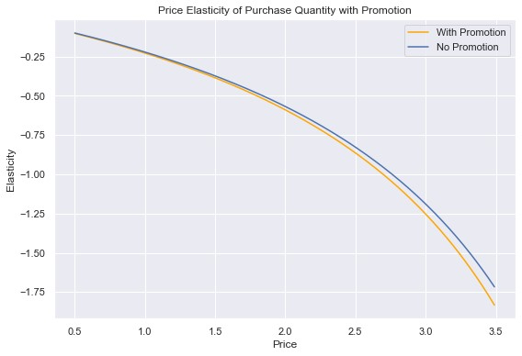
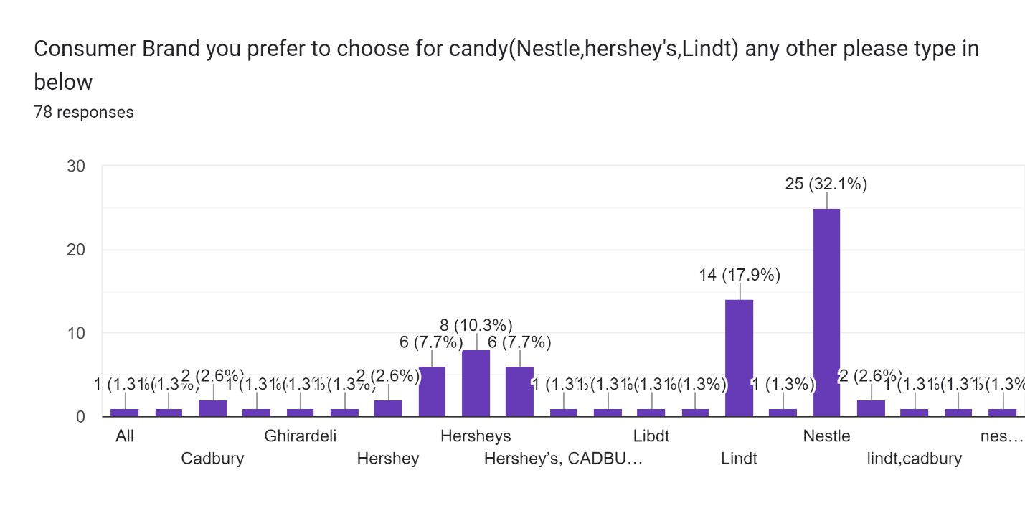
Purchase Predictive Analytics
Purchase Quantity:
Our survey Data to analyze the best brand and price range:
Insight: It appears that promotion does not appear to be a significant factor in the customers' decision what quantity of chocolate candy bars to purchase.
Nestle Seems to be the top candy bar brand preferred by consumers.

Slide 22
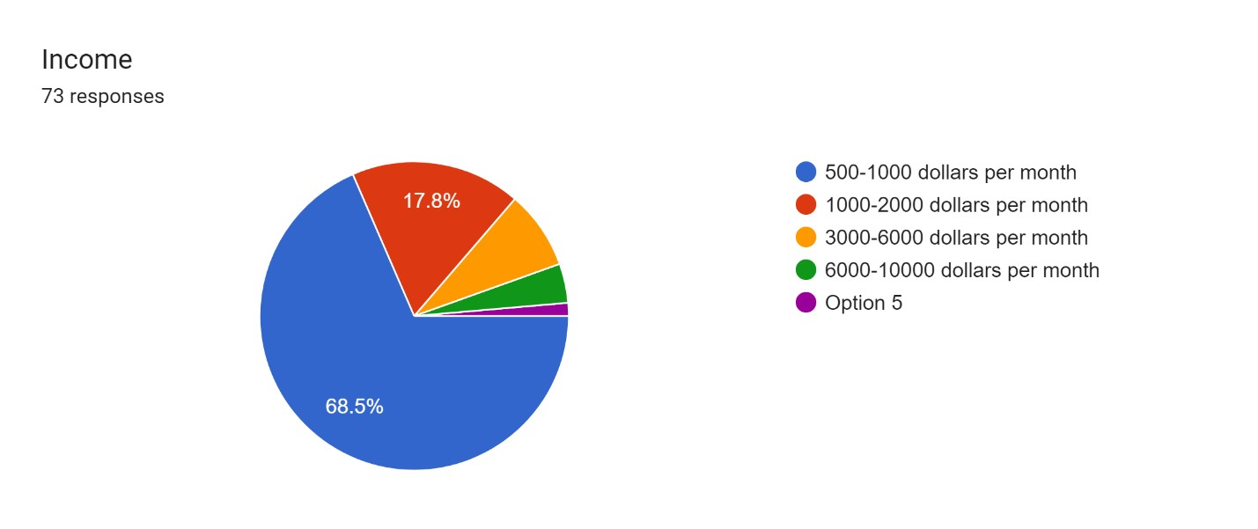
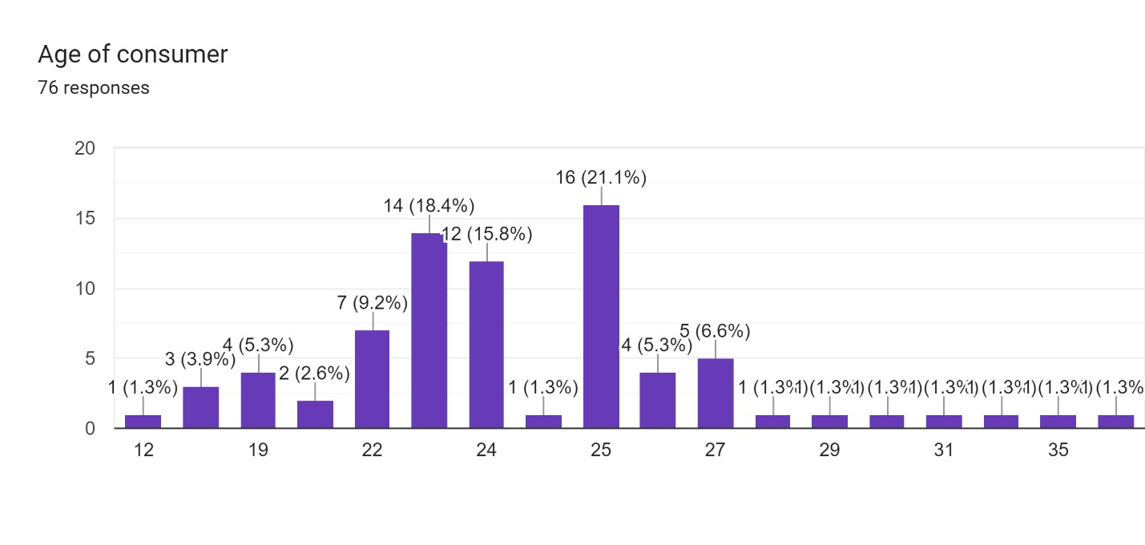
Purchase Predictive Analytics
Income:
Age of Consumer:
As the majority people are students for the survey response the income range lies around 1000 dollars per month.
Average age of consumer as per survey seems to be 24.

Slide 23
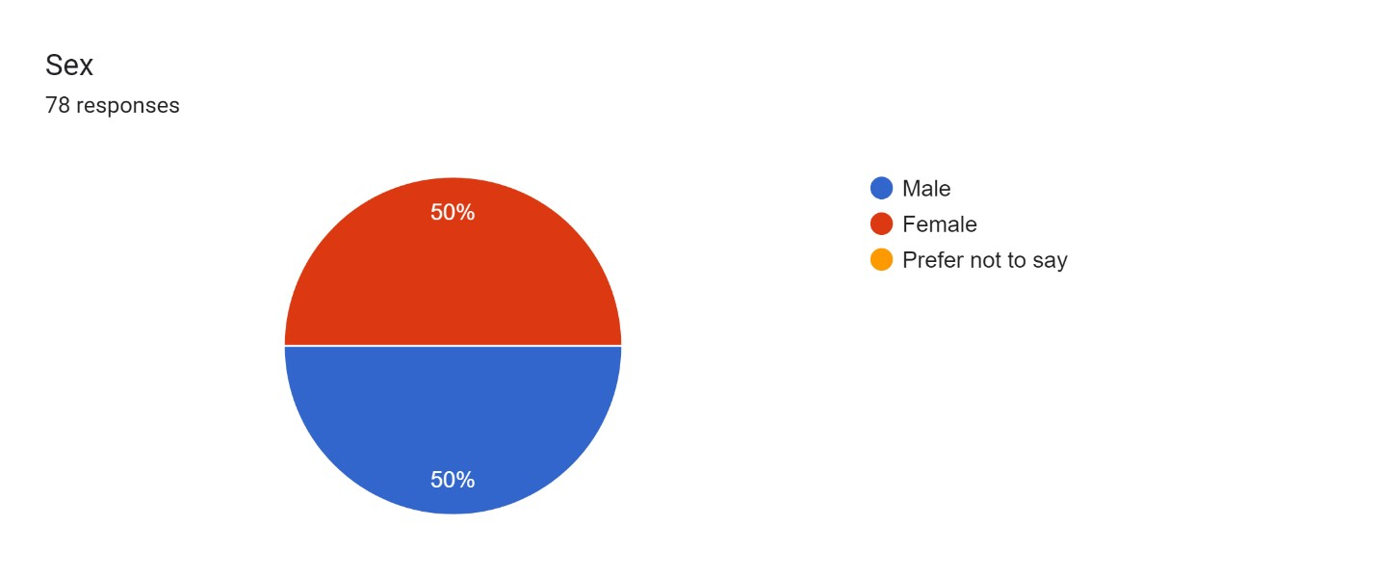
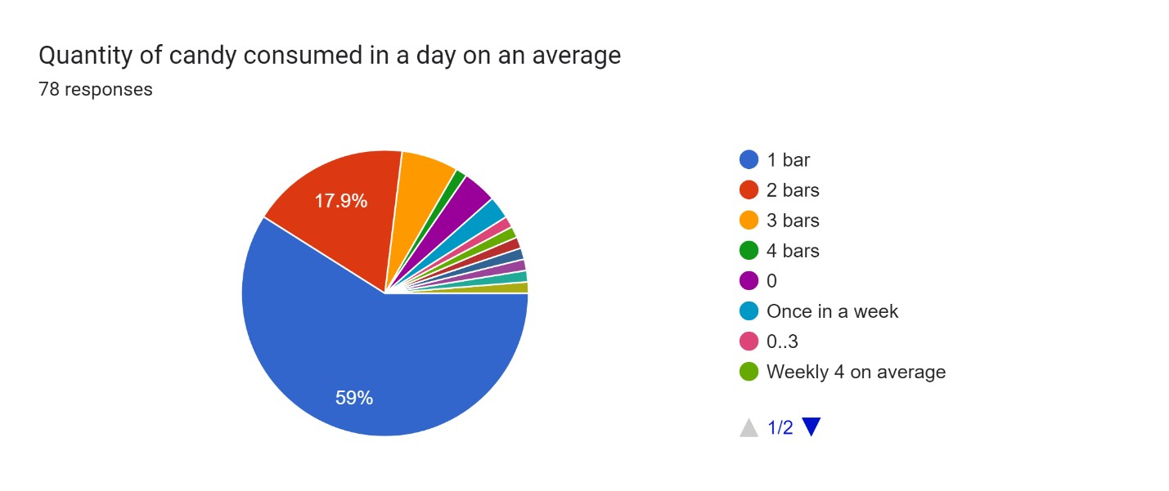
Purchase Predictive Analytics
Gender:
Quantity of candy consumed in a day on an average:
Percentage of Gender of consumer as per survey seems to be 50% for male and 50% for female
Quantity of candy bar consumed in a day on an average is around 1 bar to the max.

Slide 24
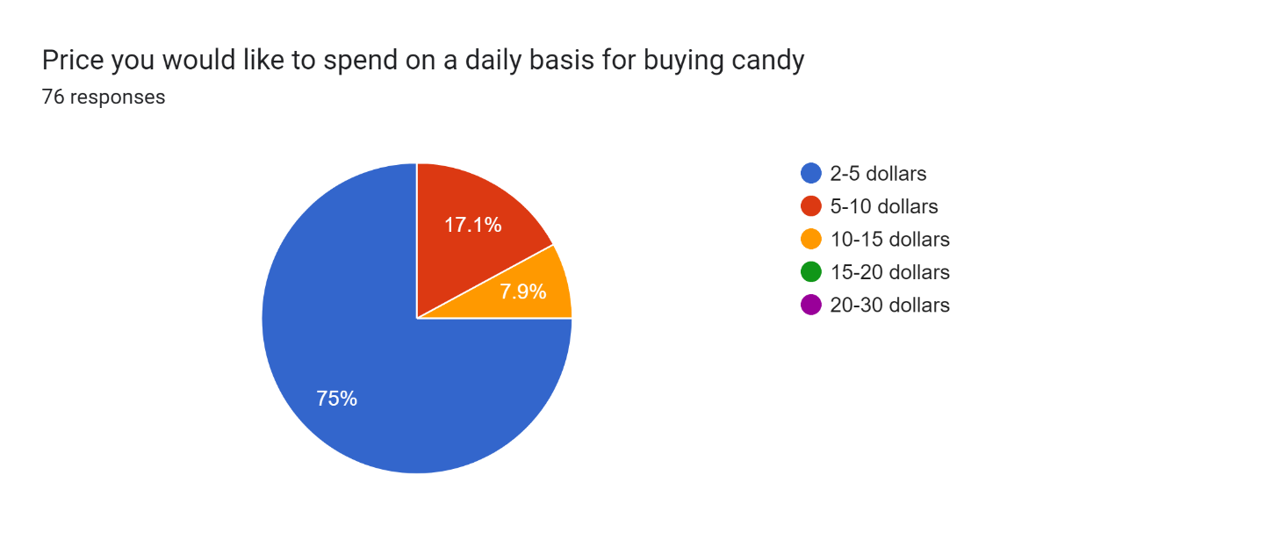
Purchase Predictive Analytics
Price:
Price of candy bar maximum of the respondents is preferred under 5 dollars.

Slide 25
Summary/Conclusion
observed price range for Brand 4 is between $1.76 and $2.6 in the region
promotion does not appear to be a significant factor in the customers' decision what quantity of chocolate candy bars to purchase.
Well-offs have the second highest turnover despite being the smallest segment
one part of the segment buys the product very frequently and another part less.
If brand 3 reduces its price, the standard segment could pivot towards it since they seem to be struggling between brand 3 and brand 2
Well-off segments mostly prefer brand 4, followed by brand 5.
For career-focused, Brand 5 could increase its price.
If the price is below the 1.25, we can raise the product price without losing too much potential to buy
Fewer opportunities are more price sensitive than other groups
people are more likely to buy an item when there is a promotion than to buy it at the same price when it's not on sale
Brand 4 is no substitute for Brand 5 when it comes to the average customer.
Brand 5 can create marketing strategies that target customers who choose Brand 4 and encourage them to purchase Brand 5. well-off and retaining the career-focused segment, the most frequent buyers of brand 5.
The Career-focused segment is the most inelastic and they do not seem to be that affected by price

